Slide 1
Prediction of Chronic Kidney Disease
By: Anitha D Praveen
24th Jan 2020

Slide 2
Introduction
Chronic Kidney Disease (CKD) is a kidney disease where patients lose kidney function over time
Evaluate if the variables are able to predict the progression of disease accurately, based on longitudinal information extracted from patients diagnosed with CKD
CKD diagnosis just on eGFR alone has not been effective as it has low specificity and sensitivity in detecting patients

Slide 3
Approach
Patient Information
Total number of patients: 300
Race, Gender, Age, Diastolic Blood Pressure, Systolic Blood Pressure, Hemoglobin, Creatinine, Glucose, Low Density Lipoproteins, Medications
Disease Progression (Class) – 200 patients did not progress to next stage of CKD and 100 patients did
7 numeric predictors and 4 nominal predictors including Class
Missing values denoted with NaN and eventually dropped for the purpose of CKD disease prediction

Slide 4
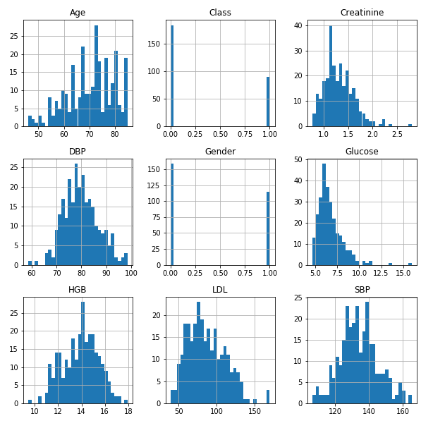
Results & Key Findings
1. Descriptive Statistics of predictors
Mean age of patients is 70 (±9) years old
Numeric variables are normally distributed, except for age

Slide 5
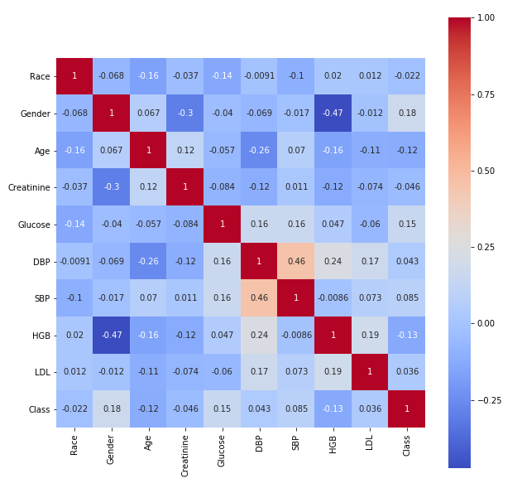
Results & Key Findings
2. Correlations between predictors
Highest Pearson correlation observed: 0.47
Strongest correlations observed between Gender and Hemoglobin levels

Slide 6
Results & Key Findings
Classifier | Accuracy (%) | Precision score
K Neighbors Classifier | 65.5 | 0.71
SVC | 60.0 | 0
Nu SVC | 50.9 | 0.39
Decision Tree Classifier | 58.2 | 0.47
Random Forest Classifier | 65.5 | 0..71
AdaBoost Classifier | 61.8 | 0.55
Gradient Boosting Classifier | 70.9 | 0.69
Gaussian NB | 74.5 | 0.79
Linear Discriminant Analysis | 65.5 | 0.67
Logistic Regression | 65.5 | 0.67
3. Comparison of Classifiers and Prediction accuracies
K Neighbors classifier, linear discriminant analysis and logistic regression: 65.5%

Slide 7
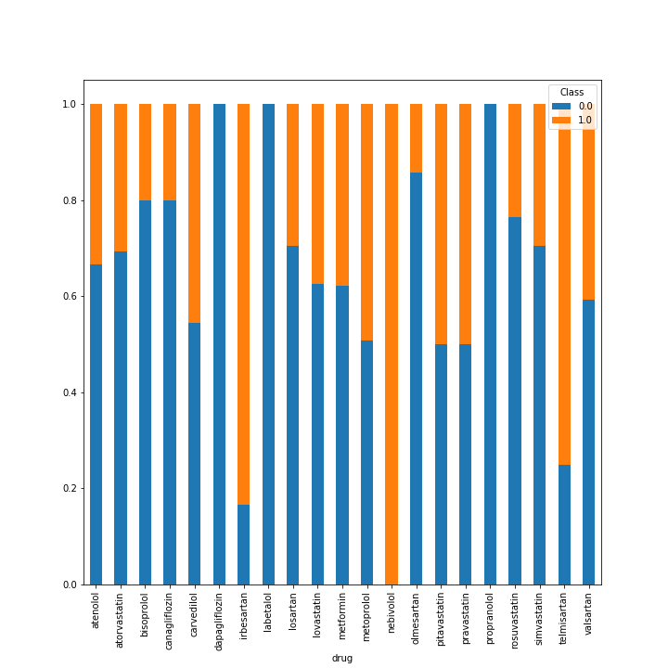
Results & Key Findings
4. Effect of Medication on CKD Progression
n = 21 different drugs administered
Atorvastatin and metformin most common
44% of atorvastatin patients and 61% of metformin patients progressed to next stage of CKD

Slide 8
Conclusion
Differences in AUCs should be analyzed to better understand the correlations between predictors.
Detailed comparisons between the prediction models to evaluate the most suitable model for CKD disease progression should also be investigated
Effect of GFR on prediction accuracies should be investigated

Slide 9
Thank you.

